Slide 1

Business
Proposal
By using CoutureAI: Clothing Image Generator Using Stable Diffusion Pipeline Solutions

Slide 2
project agenda
Project overview
Problem
Solution and recommendations

Slide 3
Project overview
This project empowers consumers to visualize their unique clothing ideas, enhancing the shopping experience and bridging the gap between imagination and reality in fashion design

Slide 4
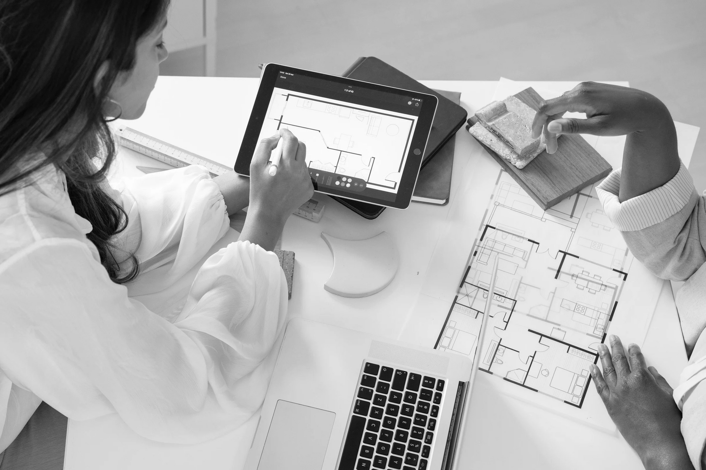
05
Problem
Traditional online shopping platforms fall short by not providing customized visual representations of user-defined styles, limiting customer satisfaction and experience.

Slide 5
Solution
RECOMMENDATIONS
1.User-Centered Customization
2.Interactive Design and Feedback
3.Integration of Fashion Trends
4.Rendering and High-Quality Visualization

Slide 6
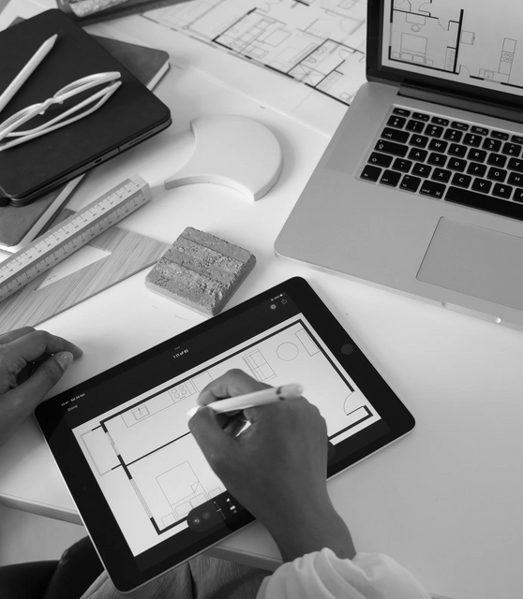
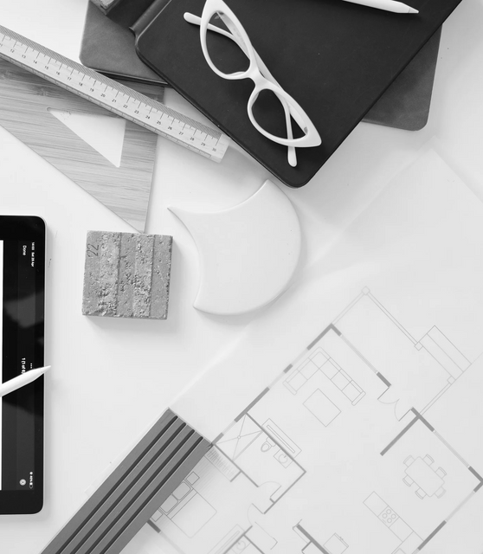
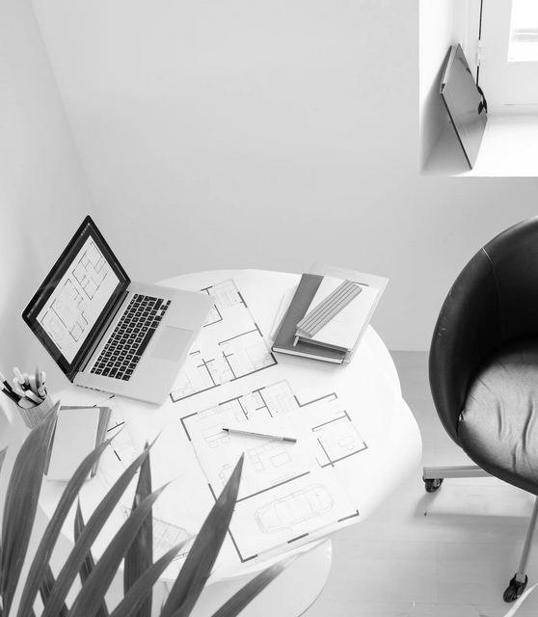
STEP 1
User Input and Customization
General steps
STEP 2
AI-Generated Clothing Design
STEP 3
Virtual Fitting and E-Commerce Integration

Slide 7




User Experience (UX) Design Skills
Latest technology
Qualifications
Advanced techniques
Data Privacy and Security

Slide 8
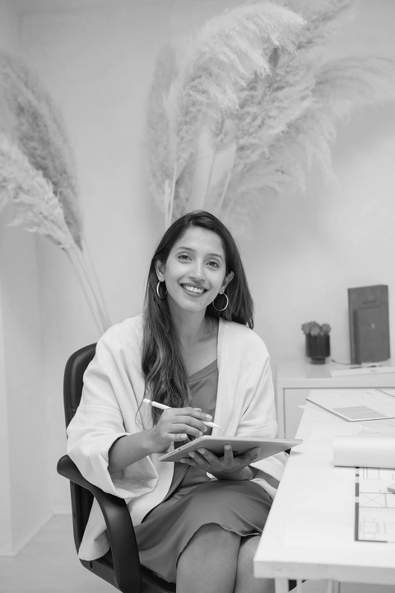

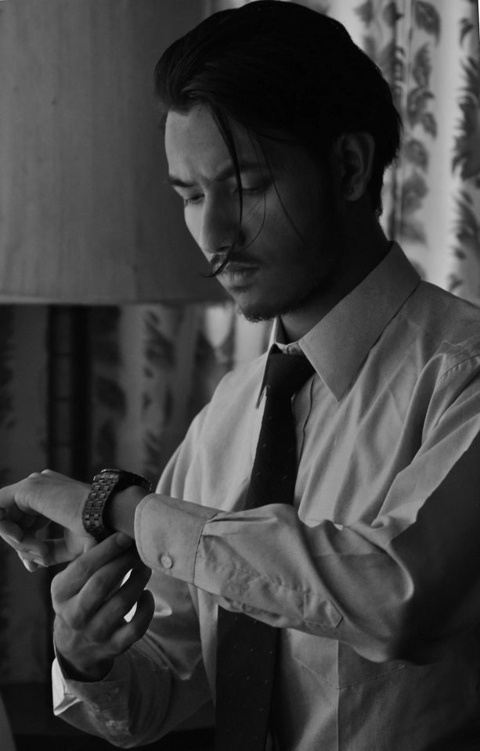
MANIKANTH
TEAM LEADER
NIKHIL
Creative manager
The team
MANI KUMAR
EDITOR
NETHANIYA
SUPPORTER

Slide 9
MAILING ADDRESS
KPRIT,GHANPUR,GHATKESAR,501301
EMAIL ADDRESS
Contact us
manikumaryepuri1@gmail.com
PHONE NUMBER
6281601480
CoutureAI: Clothing Image Generator Using Stable Diffusion Pipeline

